Slide 1
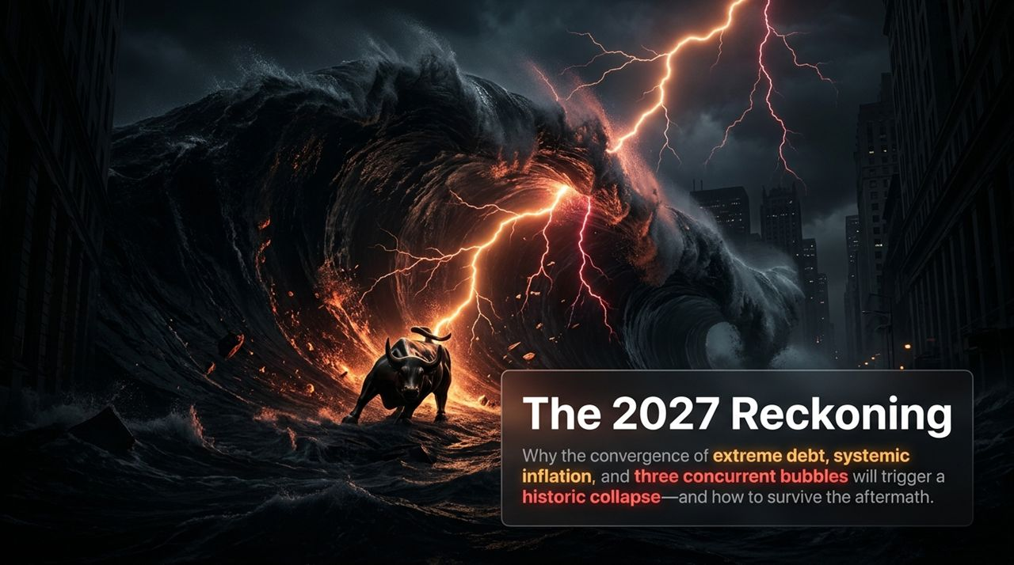
Notes:
Opening Hook: Good morning/afternoon, everyone. Thank you for joining today’s presentation. We are going to address an uncomfortable yet mathematically unavoidable economic reality that is rapidly approaching. The title of this presentation is 'The 2027 Reckoning.'
Setting the Table: For decades, investors have been trained to believe that central banks can paper over every crisis, that debt can grow indefinitely, and that asset prices can detach permanently from underlying cash flows. However, as macro strategist Michael Pento points out after 35 years of navigating market cycles, we have entered a period where those safety nets are failing.
Key Focus: Today, we are going to break down the three distinct economic forces coming together: an unprecedented convergence of sovereign debt at record levels, persistent compounding inflation, and the first concurrent 'triumvirate' of equity, real estate, and credit bubbles in modern history. Most importantly, we will discuss why 2027 represents the ultimate mathematical breaking point and provide actionable, tactical defensive steps to preserve and grow wealth through the coming storm.
Transition Cue: Let’s begin by establishing the mathematical realities framing this cycle.
Michael Pento: 2027 Will Be a Very Difficult Year – Here's Why
https://www.youtube.com/watch?v=lqgYjFky-Po

Slide 2
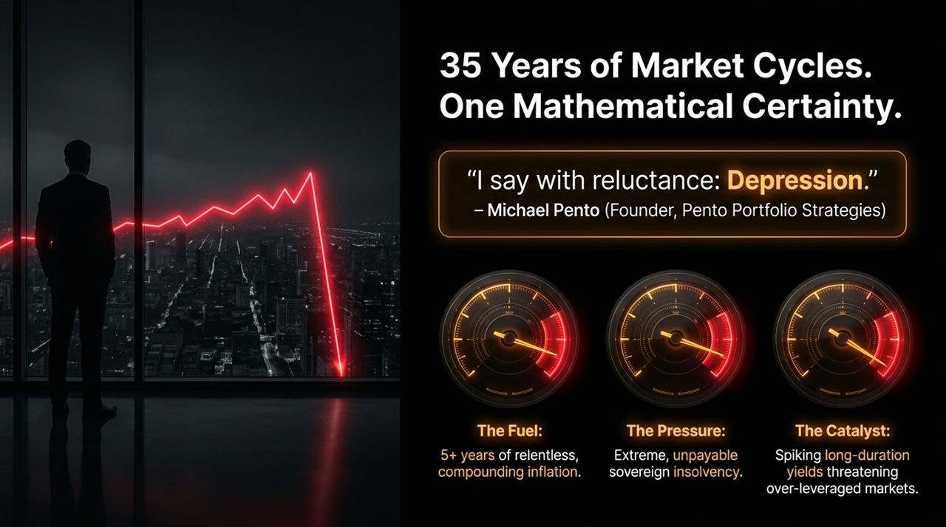
Notes:
The Macro Context:When a veteran macro strategist with 35 years of experience says, 'I say with reluctance: Depression,' it is not hyperbole or permabear doom-mongering. It is the result of rigorous, data-driven modeling.
Deconstructing the Three Pressures:
1. The Fuel (Compounding Inflation): First, consider the fuel. For over five years, the bottom 80% of consumers have been battered by relentless, compounding inflation. Even if headline CPI moderates slightly, the cumulative price increase since 2020 remains locked into everyday living costs—from energy to groceries.
2. The Pressure (Sovereign Insolvency): Second, the pressure. The sovereign balance sheet of the United States is mathematically insolvent. Debt service costs are exploding at a rate that outpaces tax receipts.
3. The Catalyst (Spiking Long-Duration Yields): Third, the catalyst. In every historical market cycle, it is never earnings revisions or consumer sentiment that pops asset bubbles—it is the credit market. Rising long-duration yields force a sudden re-pricing of all debt and over-leveraged assets.
Core Takeaway: When you combine high inflation, unpayable sovereign debt, and rising interest rates, the structural economic model breaks.
Transition Cue: To understand why this is mathematically guaranteed, let's examine the numbers behind the sovereign debt burden.

Slide 3
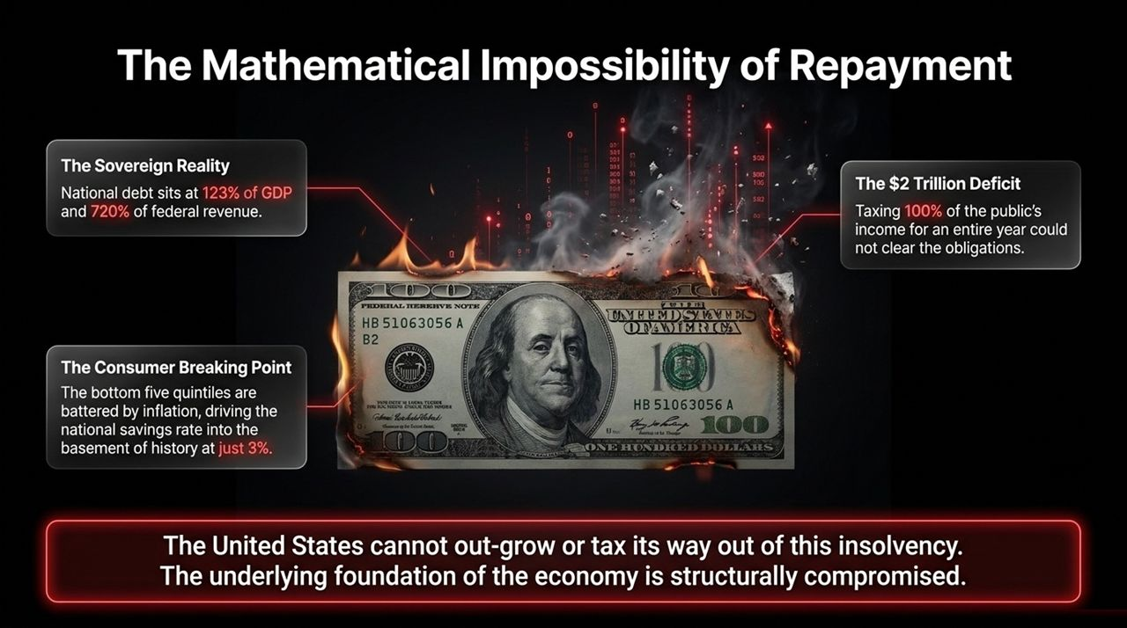
Notes:
The Sovereign Reality:
Let's dispel a common myth often repeated in financial media: that the US can easily grow or tax its way out of its current debt load. US National Debt now stands at 123% of GDP and an alarming 720% of federal revenue.
The Taxing Thought Experiment:
To illustrate how absurd the situation is: if the federal government were to tax 100% of the public's income for an entire year—meaning no one receives a single dollar after tax—it still would not clear total obligations. Obviously, no worker would show up to work for a 100% tax rate. Therefore, growth and taxation alone cannot solve this.
Annual Deficits & The Consumer:
We are now running $2 trillion annual deficits during nominal economic expansion. Meanwhile, the consumer—who accounts for roughly 70% of GDP—is completely exhausted. Personal savings rates have collapsed to 3%, placing them in the basement of historical benchmarks.
Bottom Line: The underlying foundation of the economy is structurally compromised. When debt service costs exceed organic revenue growth, the system must either default or hyper-inflate.
Transition Cue:
Now that we see the sovereign foundation is cracked, let's look at where that debt-fueled speculation went—into three concurrent asset bubbles.

Slide 4
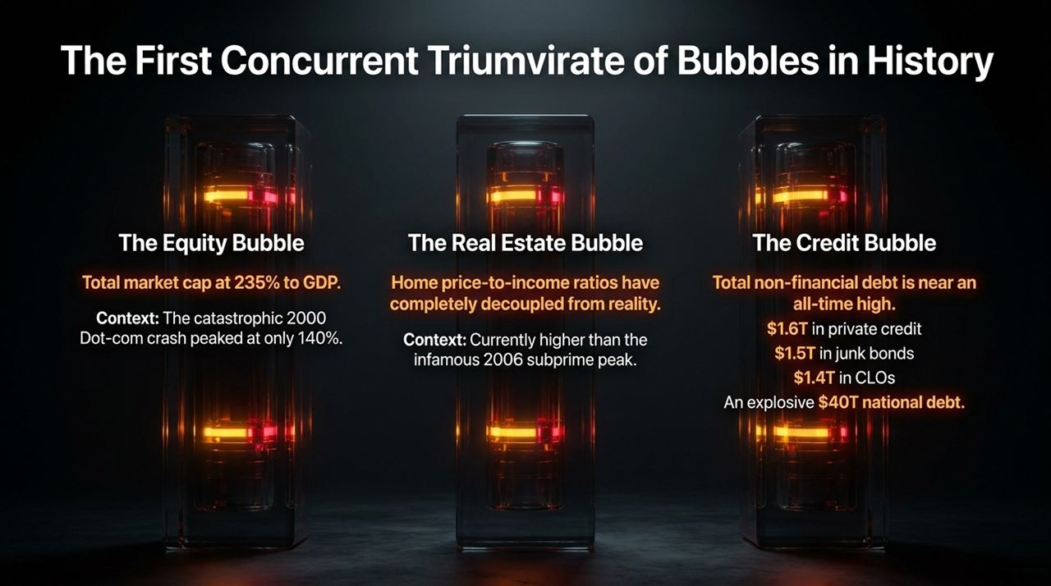
Notes:
Defining the Triumvirate:
In past economic crises, asset bubbles occurred in isolation. In 2000, we had a tech/equity bubble, but housing and credit were relatively stable. In 2007, we had a real estate and subprime mortgage bubble, while equities were not nearly as stretched valuation-wise. Today, for the first time in history, we face a concurrent Triumvirate of Bubbles across Equities, Real Estate, and Credit.
1. The Equity Bubble:
Total US equity market capitalization sits at 235% of GDP. For context, at the absolute peak of the 2000 Dot-com mania, market cap to GDP peaked at only 140%.
2. The Real Estate Bubble:
Home price-to-income ratios have completely decoupled from median household purchasing power, reaching levels higher than the 2006 subprime peak.
3. The Credit Bubble:
Underpinning both is a massive credit bubble. Non-financial debt is near record highs, featuring $1.6 trillion in opaque private credit, $1.5 trillion in high-yield junk bonds, $1.4 trillion in CLOs, and a $1 trillion annual debt-financing machine for AI infrastructure.
Transition Cue:
What kept these three bubbles afloat for so long? Global artificial rate suppression—an anchor that has now officially snapped.

Slide 5
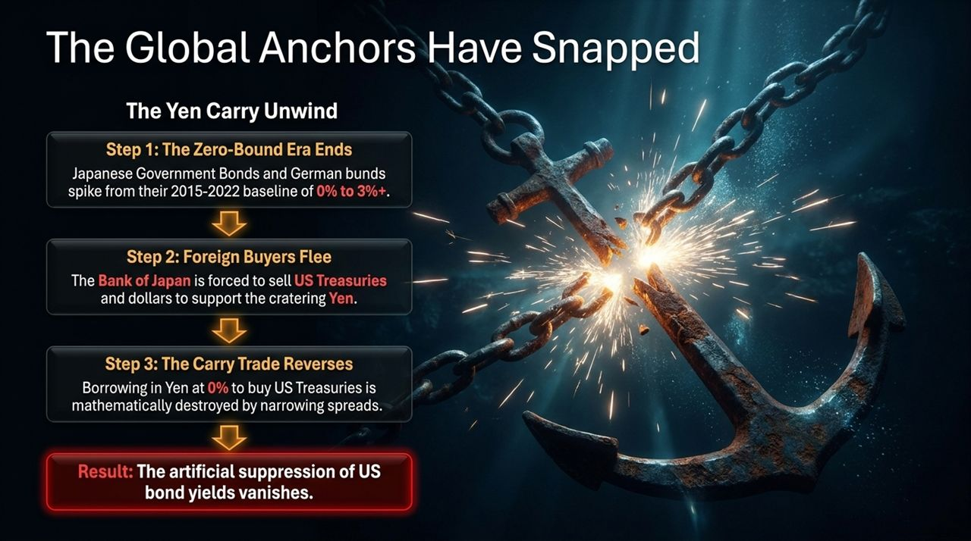
Notes:
The Mechanics of Global Rate Anchors:
From 2015 to 2022, global capital markets enjoyed an artificial floor. Central banks in Japan and Europe maintained zero or negative interest rates, suppressing yields worldwide.
Step-by-Step Breakdown of the Unwind:
Step 1: Yield Shift. Japanese Government Bonds (JGBs) and German Bunds have spiked from 0% toward 3%+. The era of zero-bound rates is over.
Step 2: Foreign Capital Flight. To defend a collapsing Yen, the Bank of Japan has been forced to liquidate US Treasuries and dollars. Foreign central banks are no longer price-insensitive buyers of US debt; they are sellers.
Step 3: The Carry Trade Reverses. For decades, hedge funds borrowed in Japanese Yen at 0% to buy higher-yielding US Treasuries. As Japanese rates rise and currency volatility surges, that spread narrows, destroying the trade and forcing massive unwinds.
Key Takeaway: The international mechanism that suppressed US long-term interest rates has vanished.
Transition Cue:
Now, let's examine the exact mechanism that will pop these three bubbles.

Slide 6
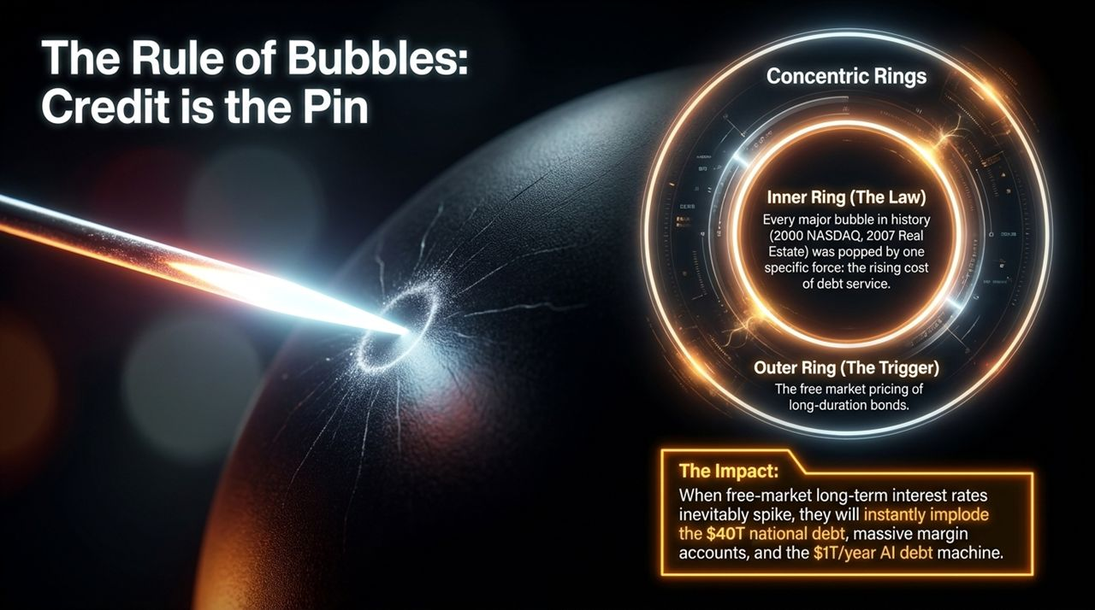
Notes:
The Historical Law:
There is a fundamental law in financial history: Credit is the pin that pops every bubble. Whether it was NASDAQ in 2000 or housing in 2007, asset bubbles do not burst on their own; they pop when debt service costs rise beyond the borrower's capacity to pay.
The Inner vs. Outer Ring:
The inner ring is debt service costs. The outer ring—the ultimate trigger—is the free-market pricing of long-duration bonds.
The Immediate Impact:
When long-term yields spike, the cost of capital surges across every layer of the economy. It immediately destabilizes $40 trillion in national debt, squeezes corporate credit lines, spikes mortgage rates, and crushes leveraged AI capital expenditure plans.
Transition Cue:
This brings us to a massive policy clash occurring right now in Washington between monetary and fiscal authorities.

Slide 7
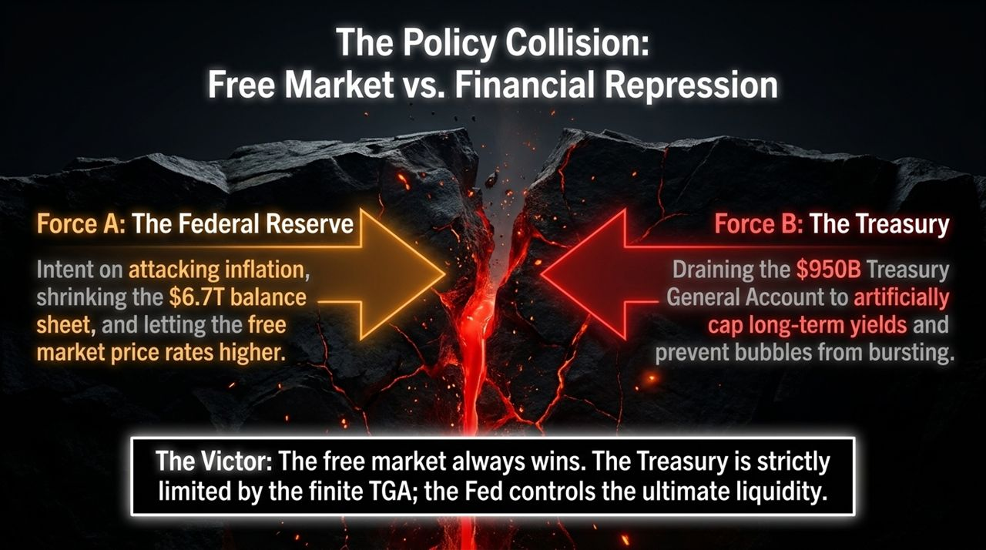
Notes:
The Conflict:
Behind closed doors, we are witnessing an intense tug-of-war between the Federal Reserve and the US Department of the Treasury.
Force A (The Federal Reserve):
The Fed is focused on fighting inflation, holding policy rates elevated, and shrinking its $6.7 trillion balance sheet, allowing free-market forces to price long-term debt.
Force B (The Treasury):
The Treasury, aware that high yields threaten sovereign liquidity, attempts financial repression. By manipulating issuance toward short-dated T-bills and draining the Treasury General Account (TGA)—which sits around $950 billion—the Treasury attempts to artificially cap long-term yields.
Who Wins?
The free market always wins in the end. Draining the TGA is a finite tactic—the Treasury cannot run its operational checking account to zero without defaulting on obligations. Once the TGA buffer is exhausted, the Treasury loses its ability to suppress yields.
Transition Cue:
When policy tools run out, all three economic gears lock up, pointing directly to 2027.

Slide 8
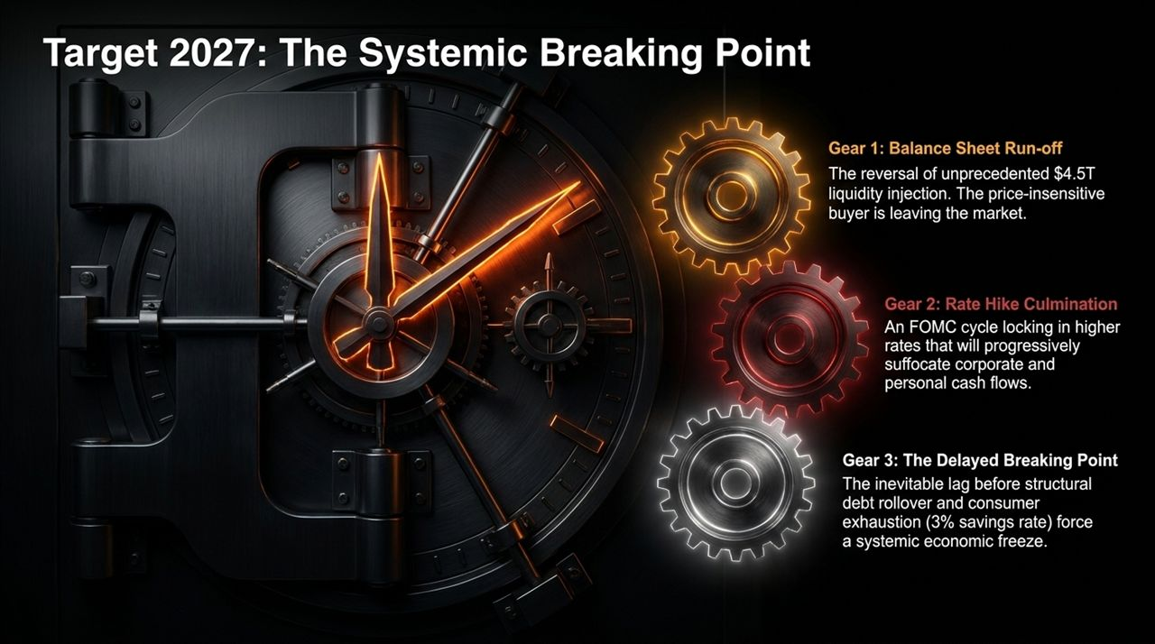
Notes:
Why 2027?
Why pinpoint 2027 as the systemic breaking point? It comes down to the synchronization of three mechanical gears.
Gear 1: Quantitative Tightening & Balance Sheet Run-off:
The Fed’s balance sheet run-off removes the primary price-insensitive buyer from the market. Private capital must step in to absorb trillions in new debt.
Gear 2: Lagged Impact of High Rates:
Interest rate changes operate with long and variable lags. While corporate and consumer debt was locked in at low rates during 2020–2021, those low-rate hedges expire rapidly over the next two years.
Gear 3: Debt Rollover Wall:
In 2026 and 2027, hundreds of billions in corporate debt, commercial real estate loans, and Treasury notes must be rolled over at double or triple their original coupon rates. Combined with a consumer savings rate of just 3%, cash flows will freeze.
Transition Cue: Once this wall is hit, the crisis unfolds in four distinct, cascading phases.

Slide 9
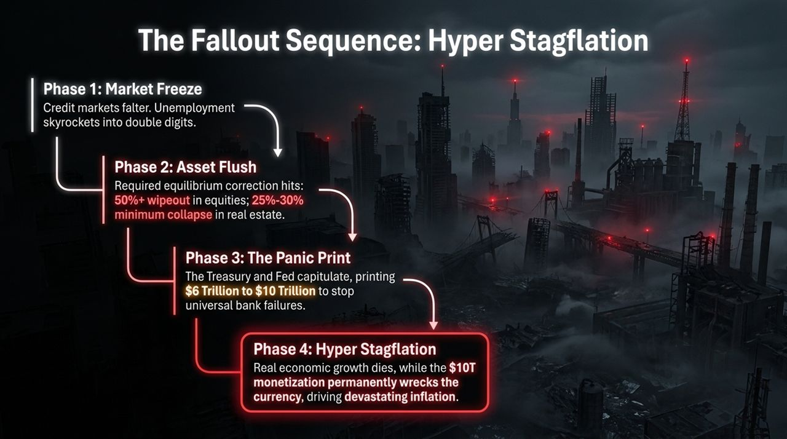
Notes:
Phase 1: Market Freeze & Credit Crunch:
As debt rollovers fail, credit markets freeze. Corporate defaults surge, businesses slash capital expenditures, and unemployment escalates toward double digits.
Phase 2: The Asset Flush:
To match high yield realities, markets undergo a valuation reset. Equities face a 50%+ drawdown to reach historical average price-to-earnings ratios. Real estate prices drop by 25% to 30% to align with reduced borrowing capacity.
Phase 3: The Panic Print:
Faced with banking insolvencies and failing pension funds, central bankers will capitulate. Expect a massive monetary injection—printing between $6 trillion and $10 trillion to bailout systemically important institutions.
Phase 4: Hyper Stagflation:
Unlike 2008, printing trillions in a supply-constrained, high-debt world will not lead to economic recovery. It destroys purchasing power, leading to Hyper Stagflation—flat-to-negative real GDP growth combined with persistent inflation.
Transition Cue:
This phase completely destroys traditional portfolio management strategies.

Slide 10
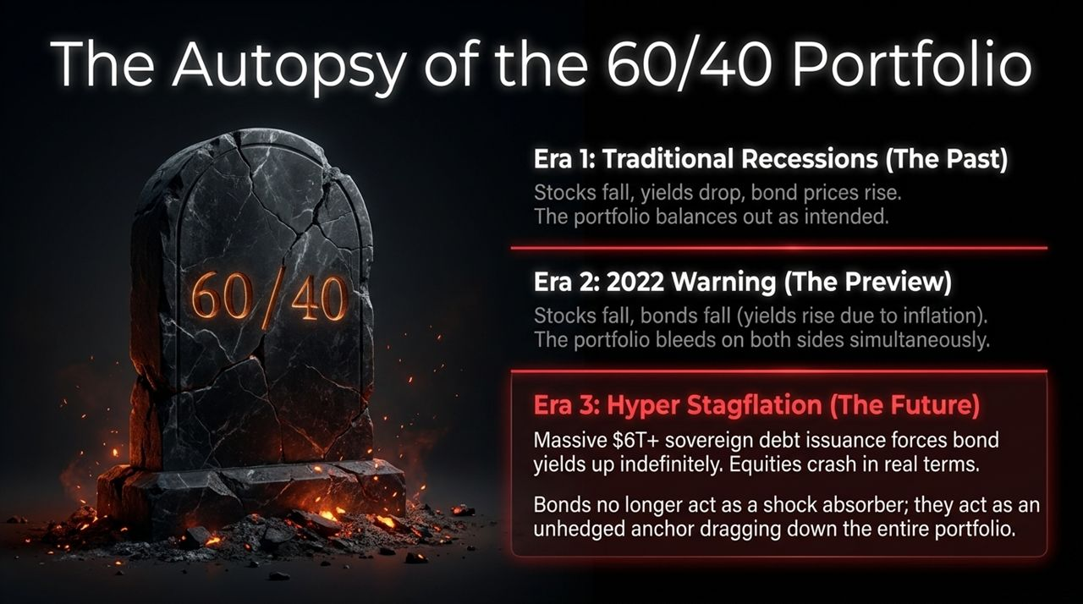
Notes:
The Historical Promise of 60/40:
For 40 years, the 60/40 portfolio was the benchmark for balanced asset allocation. When equities fell during economic downturns, central banks cut interest rates, driving up bond prices and buffering stock losses.
The 2022 Warning:
In 2022, investors received a prelude to what is coming: as inflation surged, both stocks and bonds dropped simultaneously.
The Hyper-Stagflationary Reality:
In the upcoming hyper-stagflationary cycle, the Treasury will issue $4 to $6 trillion in new debt annually to finance deficits. Bond yields will remain elevated despite weak economic growth. Bonds will no longer act as a shock absorber; they become an unhedged anchor dragging down total portfolio returns.
Transition Cue:
So where do you allocate capital when both traditional paper assets fail? You look to Sector 5.

Slide 11
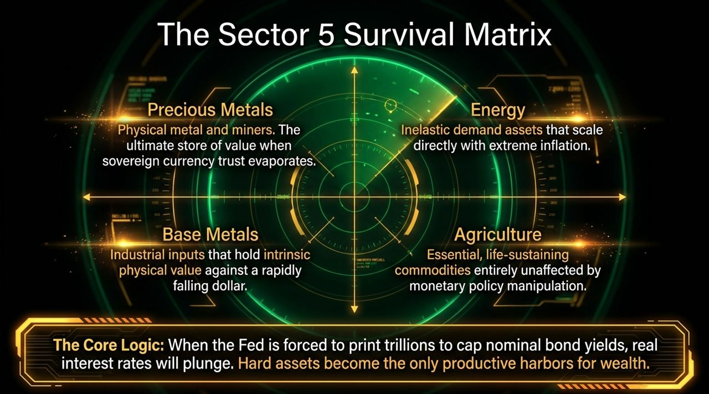
Notes:
Introducing Sector 5:
Through extensive back-testing across multi-decade macroeconomic cycles, 'Sector 5' represents the optimal allocation during hyper-stagflationary regimes.
The Four Core Pillars:
1. Precious Metals: Physical gold, silver, and select miners. These act as the primary store of value when fiat currencies dilute.
2. Energy: Oil and gas infrastructure. Energy exhibits inelastic demand and directly captures inflationary upside.
3. Base Metals: Copper, nickel, and industrial inputs. They maintain intrinsic physical value regardless of monetary policy shifts.
4. Agriculture: Essential soft commodities. Food demand remains constant regardless of economic conditions.
The Underlying Logic:
When nominal bond yields are artificially capped while inflation remains high, real interest rates plunge into deep negative territory. Physical, hard assets become the primary means of capital preservation.
Transition Cue: How do we position portfolios tactically during the remaining window before this break occurs?

Slide 12
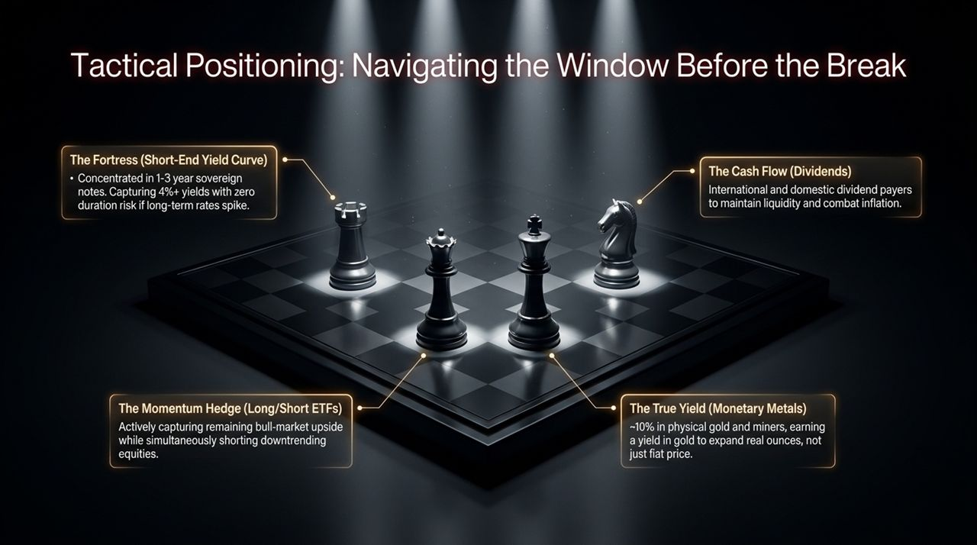
Notes:
Navigating the Interim Window:
We are not net short today because credit spreads have not yet blown out. We want to participate safely while building a defensive fortress.
Tactical Allocation Strategy:
1. The Fortress (Short-End Yield Curve): Position heavily in 1-to-3 year sovereign Treasuries. This captures 4%+ risk-free yields without exposing capital to duration risk if long-term yields surge.
2. Cash Flow (High-Quality Dividends): Maintain exposure to high-dividend international and domestic equities with strong pricing power.
3. Momentum Hedging: Utilize active long/short strategies to remain invested in uptrending sectors while shorting vulnerable equities.
4. True Yield (Monetary Metals): Hold ~10% in physical gold and high-grade miners, focusing on earning yield in physical gold ounces rather than fiat paper dollars.
Transition Cue:
Time is short, and the window to prepare is closing.

Slide 13
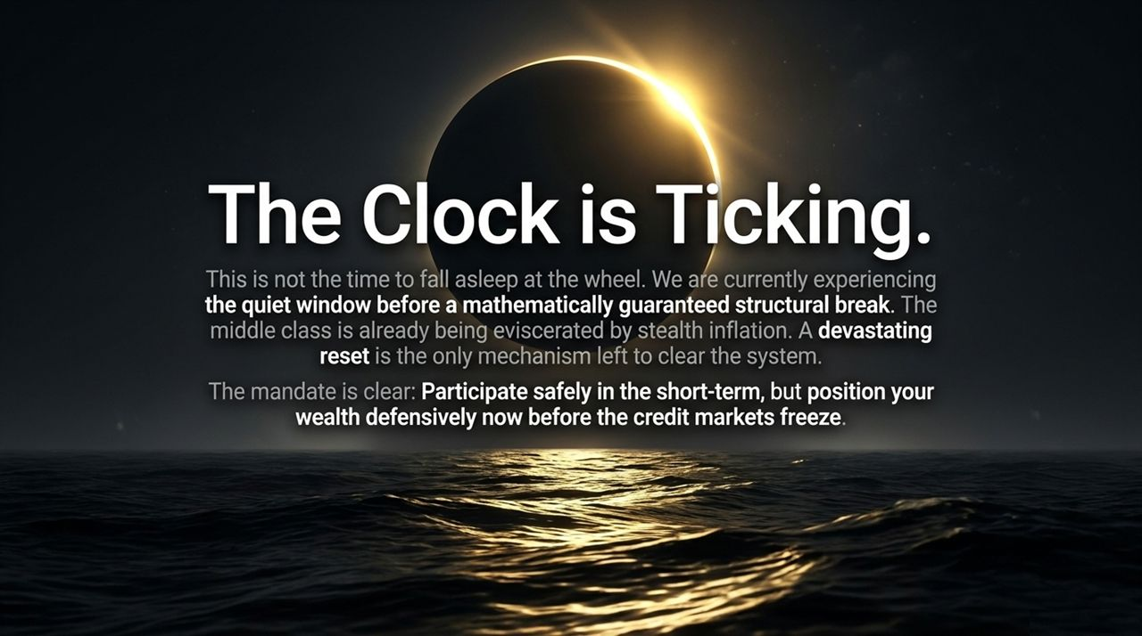
Notes:
The Call to Action:
We are currently in the quiet window before a structural market break. Stealth inflation is continually eroding purchasing power.
Urgency:
Waiting for credit markets to freeze before adjusting your portfolio will be too late. Liquidity disappears instantly when credit events occur.
Core Takeaway:
Participate in the market safely today, but structure your wealth defensively now before the transition takes place.
Transition Cue: Let's summarize the entire macro framework on our final slide.

Slide 14
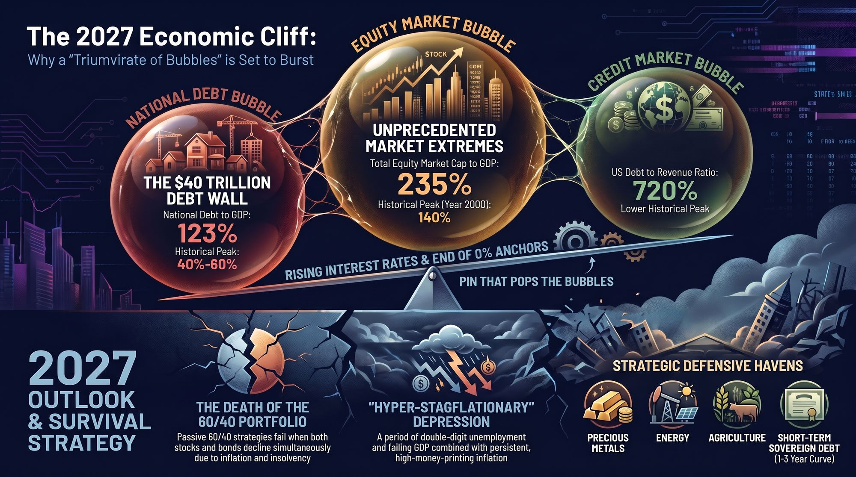
Notes:
Recap of the Systemic Equation:
To summarize the entire architecture of the 2027 Economic Cliff:
The Debt Wall: National Debt at 123% of GDP and 720% of federal revenue.
Valuation Extremes: Equities at 235% of GDP and housing price-to-income at record highs.
The Pin: Spiking long-duration rates breaking $40T in total credit debt.
The Outcome: The death of the passive 60/40 portfolio and the arrival of a Hyper-Stagflationary Depression.
Defensive Playbook:
Shift capital into precious metals, energy, agriculture, and 1-to-3 year sovereign short-term debt.
Closing Statement:
Thank you for your time today. I am now happy to open the floor to any questions.
Michael Pento: 2027 Will Be a Very Difficult Year – Here's Why
https://www.youtube.com/watch?v=lqgYjFky-Po

